Slide 1
Ukrainian Association for Feminine Research in Art Ukrainian Association for Feminine Research in Artзначний прогрес у соціальному захисті громадян
Traditions and innovations in the Ukrainian women’s art
Iryna Akimova, PhD in Economics, Leader of the Ukrainian Association for Feminine Research in Arts (UAFRA)
The 8th International Exhibition of Traditional Fine Arts
The 6th International (Shanghai) Intangible Cultural Heritage Protection Forum
7-8th of June, 2018, Shanghai
Notes:
«Руководящие принципы по вопросу о перемещении лиц внутри страны» http://www.ohchr.org/Documents/Issues/IDPersons/GPRussian.pdf

Slide 2
Ukrainian Association for Feminine Research in Art Ukrainian Association for Feminine Research in Artзначний прогрес у соціальному захисті громадян
Women’s art in Ukraine has long and rich traditions
It has always been based on the rich folkloristic background and cultural traditions mixed with creativity and search for new approaches;
Ukrainian women artists got international recognition and contributed to the development of new esthetics of Ukrainian and international art .
Notes:
«Руководящие принципы по вопросу о перемещении лиц внутри страны» http://www.ohchr.org/Documents/Issues/IDPersons/GPRussian.pdf

Slide 3
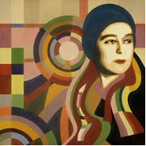
Ukrainian Association for Feminine Research in Art Ukrainian Association for Feminine Research in Artзначний прогрес у соціальному захисті громадян
Ukrainian women’s art at the beginning of the 20th century
Great influence of European art
Maria Bashkirtseva, Sonia Delaunay, Sofia Levytska, Sofia Zarytska, Alexandra Exter
Sonia Delaunay - a great master of art-deco and the founder of a new style in avant-garde painting- Orphysm. The first women artist who had a solo exhibition in the Louvre during her lifetime (in 1964).
Notes:
«Руководящие принципы по вопросу о перемещении лиц внутри страны» http://www.ohchr.org/Documents/Issues/IDPersons/GPRussian.pdf

Slide 4
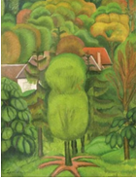
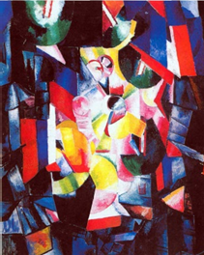
Протягом 2010-2013 років забезпечено Ukrainian Association for Feminine Research in Art Ukrainian Association fгромадян
Ukrainian women’s art at the beginning of the 20th century
Sofia Levitska: Her paintings represent synthesis of a
primitive art ,Ukrainian folkloristic traditions ,
and modern trends of the European art;
Member of the Committee of the
Salon d'Automne in Paris .
Alexandra Exter ( 1882-1949): made an important contribution
to the European Cubism and Futurism .
Her cubistic paintings were full of bright colors of the rainbow .
She was fascinated by Ukrainian folk art
from which she borrowed motives for some of her paintings.
Notes:
«Руководящие принципы по вопросу о перемещении лиц внутри страны» http://www.ohchr.org/Documents/Issues/IDPersons/GPRussian.pdf

Slide 5
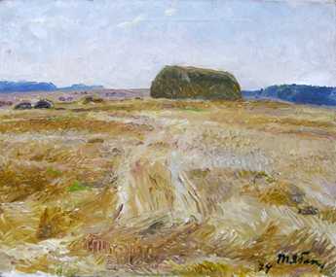
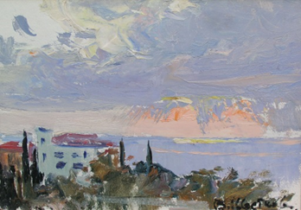
Ukrainian Association for Feminine Research in Art Ukrainian Association for Feminine Research in Artзначний прогрес у соціальному захисті громад н
Ukrainian women’s art in 1930- 1990
Socialist realism + diversity of approaches to art and stylistic search
Tatyana Yablonska ( 1917- 2005): painted both life-affirming huge
canvases in the style of socialist reliasm , very decorative pictures
based on folk motifs of Western Ukraine and elegant portraits
and landscapes influenced by the masters of early Renaissance.
The year 1997 was declared the year of Yablonska by UNESCO,
In 2000 in Cambridge she became the Woman of the Year.
Valentina Tsvetkova ( 1917- 2007): a famous master of landscape
and still life. She imbedded in her work the best traditions
of Ukrainian realistic school, Russian and French impressionism.
Notes:
«Руководящие принципы по вопросу о перемещении лиц внутри страны» http://www.ohchr.org/Documents/Issues/IDPersons/GPRussian.pdf

Slide 6
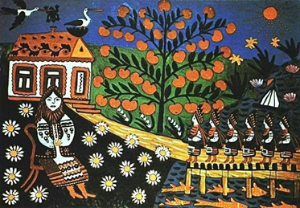
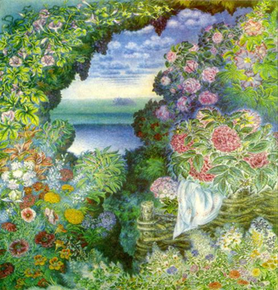
Протягом 2010-2013 років забезпечено Ukrainian Association for Feminine Research in Artaini Association for Feminine Research in Artзначний прогрес у соціальному захисті громадя н
Ukrainian women’s art in 1930- 1990
Unique style of “ folk” artistists
Maria Primachenko: self educated painter.
Combined in her work drawing and painting.
Created a lot of original floral and bird compositions
as well as genre paintings. Her unique cycle of fantastic animals
is highly emotional and full of folk wisdom.
The Year 2009 was declared by UNESCO the year of Maria Prymachenko.
Katerina Bilokur ( 1900- 1961) : a representative of national decorative
painting and art naїve. A master of “floral icon painting”.
Her still life and floral compositions are full of light and optimistic
bright colors , elegance and creativity.
Pablo Picasso said about her:
"If we had an artist of this level of skills,
we would have made a whole world to talk about her”
Notes:
«Руководящие принципы по вопросу о перемещении лиц внутри страны» http://www.ohchr.org/Documents/Issues/IDPersons/GPRussian.pdf

Slide 7
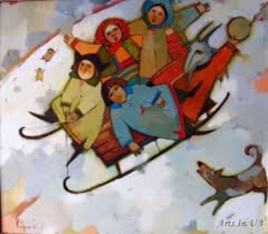
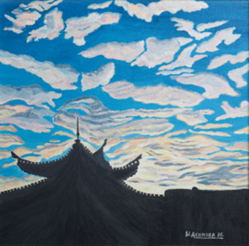
Протягом 2010-2013 років забезпечено Ukrainian Association for Feminine Research in Art Ukrainian Association for Feminine Research in Artзначний прогрес у соціальному захисті громадя н
Modern Ukrainian women artists
Inspirations from traditions of Ukrainian culture + Continuous search of new creative art solutions.
Natalia Korf-Ivanyuk: works in mixed technique
combining oil paintings and graphics. Interested
in studying ethnic motives and the connection
of the present with the past. Still life and genre
paintings have distinguished folkloristic notes
Iryna Akimova: a representative of modern figurative art.
Landscapes and still life paintings reflect her own
philosophical interpretation of social and ethical issues.
Studies a constructive compromise between national cultural
traditions and innovations
Oksana Chepelyk: besides painting uses photo, video,
and documentary film to analyze ethical, philosophical
and social aspects of culture.
Notes:
«Руководящие принципы по вопросу о перемещении лиц внутри страны» http://www.ohchr.org/Documents/Issues/IDPersons/GPRussian.pdf

Slide 8
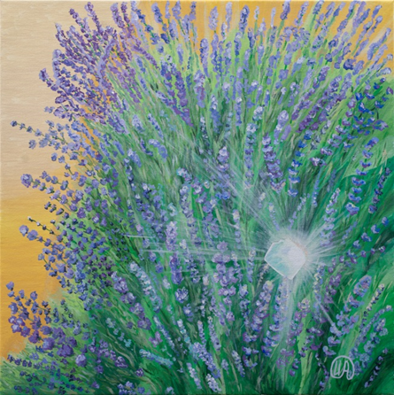
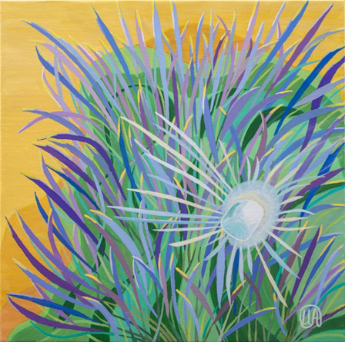
Протягом 2010-2013 років забезпечено Ukrainian Association for Feminine Research in Art Ukrainian Association for Feminine Research in Artзначний прогрес у соціальному захисті громадя н
Iryna Akymova: recent solo exhibition “Reflection”- philosophical discussion on diversity and common basis in human life
«We reflect the same phenomena differently. However, both reflections have a common basis, which is represented by national traditions and cultural heritage. They put various outlooks together enriching the life and making a bridge from the past to the future».
Notes:
«Руководящие принципы по вопросу о перемещении лиц внутри страны» http://www.ohchr.org/Documents/Issues/IDPersons/GPRussian.pdf

Slide 9
Протягом 2010-2013 років забезпечено Ukrainian Association for Feminine Research in Art Ukrainian Association for Feminine Research in Artзначний прогрес у соціальному захисті громадя н
Women’s art needs support.
Women artists face challenges in terms of unequal access to career opportunities, selling their work and gaining recognition. It is not just the phenomenon of the past.
National Museum of Women in the Arts:
51 per cent of visual artists today are women,
But 78 per cent of the galleries represent more men than women
The director of Saatchi gallery Nigel Hirst :
“Despite the active position of women in contemporary art, their work is still valued less than the work of men” said Nigel Hirst.
There are international organizations and institutions that support women’s art (e.g. N.A.W.A, Art Table, A.I.R. gallery , ARTinsight)
Governmental support should be complimented by that from a non-governmental sector.
Notes:
«Руководящие принципы по вопросу о перемещении лиц внутри страны» http://www.ohchr.org/Documents/Issues/IDPersons/GPRussian.pdf

Slide 10
Протягом 2010-2013 років забезпечено Ukrainian Association for Feminine Research in Art Ukrainian Association for Feminine Research in Artзначний прогрес у соціальному захисті громадя н
UAFRA promotes women’s art in Ukraine
Ukrainian Association for Feminine Research in Arts (UAFRA) has been founded one and a half years ago. It unites women from different fields of arts (visual art, literature, music, etc.) and art research.
The UAFRA is a non-partisan organization that is open to unbiased discussions and projects on women’s art , women-arts -politics relationships and the ways to strengthen gender equality in arts .
We welcome a growing aesthetic, social and political influence of women on public life and arts as one of the ways to restore public harmony. We consider women’s art as a universal language that helps to organize an open public dialogue on various issues.
The UAFRA supports the development of equal professional opportunities for women in arts and promotes women's art as an important part of national and cultural heritage.
Notes:
«Руководящие принципы по вопросу о перемещении лиц внутри страны» http://www.ohchr.org/Documents/Issues/IDPersons/GPRussian.pdf

Slide 11
Протягом 2010-2013 років забезпечено Ukrainian Association for Feminine Research in Art Ukrainian Association for Feminine Research in Artзначний прогрес у соціальному захисті н
UAFRA
Our contacts:
Leader, Akimova Iryna
e-mail: akimova.best@gmail.com
tel +380 50 330 7394
assistant,Mira Yakymchuk
e mail: jmargosha@gmail.com
tel: +380 63 671 64 25
facebook: https://www.facebook.com/UAFRA1/
Notes:
«Руководящие принципы по вопросу о перемещении лиц внутри страны» http://www.ohchr.org/Documents/Issues/IDPersons/GPRussian.pdf

